Slide 1
Introduction to Machine learning and topic modeling
Khiati Zakaria

Slide 2
Contents
Data Mining, Data analytics, Data analysis
Machine Learning
Deep Learning
Topic models

Slide 3
Data Mining, Data analytics, Data analysis

Slide 4
Introduction
Vast amounts of data are around us in our world, raw data that is mainly intractable for human or manual applications.
Data Mining is about solving problems by analyzing data present in real databases.
Data Mining is distinguished as synonym of the Knowledge Discovery in Databases (KDD) process, or as the main step of KDD.
KDD definition: “the nontrivial process of identifying valid, novel, potentially useful, and ultimately understandable patterns in data”

Slide 5
Stages
Problem Specification
Problem Understanding
Data Preprocessing
Data Mining
Evaluation
Results Exploitation

Slide 6
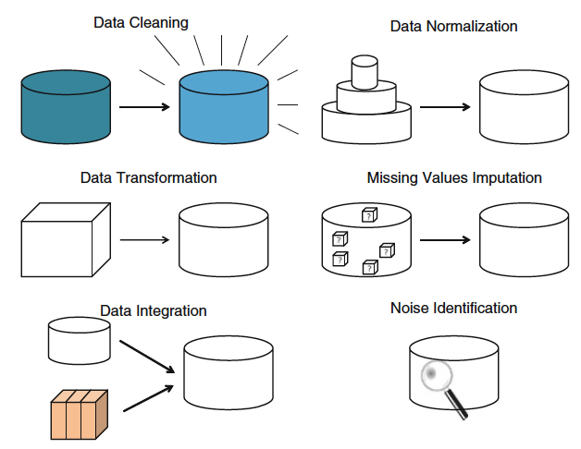
Data Preprocessing

Slide 7
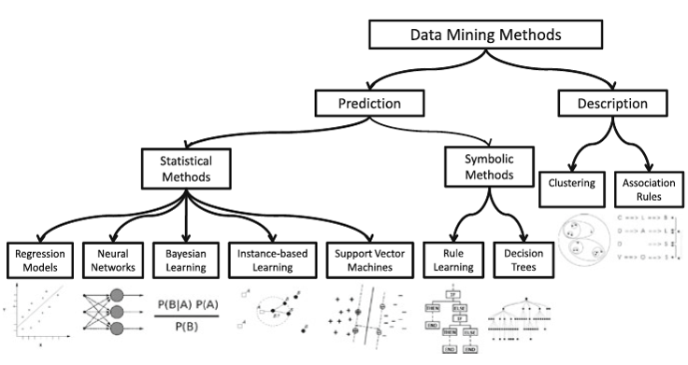
Data Mining methods

Slide 8
Machine Learning

Slide 9
Introduction
Past
Future
Learn
Predict
Training
Data
Testing
Data
Model
Model
Answer

Slide 10
Why Machine Learning?
No human experts
Industrial/manufacturing control
Mass spectrometer analysis, drug design, astronomic discovery
Black-box human expertise
Face, handwriting and speech recognition
Driving a car or flying a plane
Rapidly changing phenomena
Credit scoring, financial modeling
Diagnosis, fraud detection
Need for customization/personalization
Personalized news reader
Movie/book recommendation

Slide 11
Related fields
Statistics
Information theory
machine
learning
Decision theory
Data
mining
cognitive science
Databases
Psychological models
Neuroscience
Control theory

Slide 12
Traditional programming vs machine learning
Data
Computer
Output
Program
Data
Computer
Program
Output

Slide 13
Types of data

Slide 14

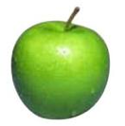
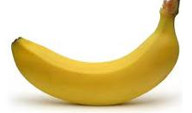
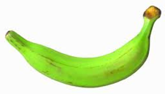
Data
Data

Slide 15

Data
Data

Slide 16
Types of data
Supervised Learning
Unsupervised Learning
Reinforcement Learning
Other types

Slide 17
Supervised learning
Classification
Logistic regression
SVM
Decision trees
k-NN
Regression
Linear regression

Slide 18
Supervised learning (Classification)
Apple
Training
Apple
Model
Banana
Banana

Slide 19
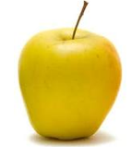
Supervised learning (Classification)
Input
Predicting
Model
Label

Slide 20
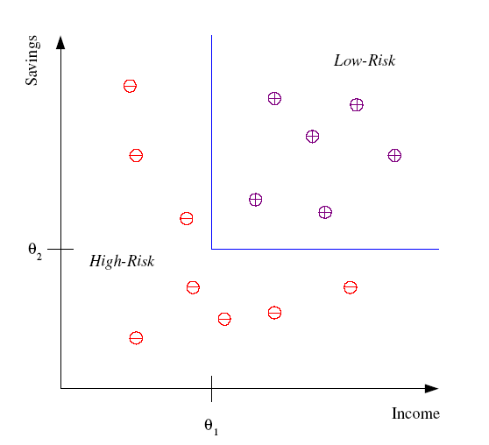
Supervised learning (Classification)
Differentiate between low-risk and high-risk customers from their income and savings

Slide 21
Supervised learning (Classification)
Face, iris, signature recognition (Security, Phone, Camera)
Handwriting recognition (Banks, Post offices)
Spam detection
Medical diagnosis: From symptoms to illnesses
Object recognition

Slide 22
Supervised learning (Regression)
-4.5
10.1
Regression: label is real-valued
3.2
4.3

Slide 23
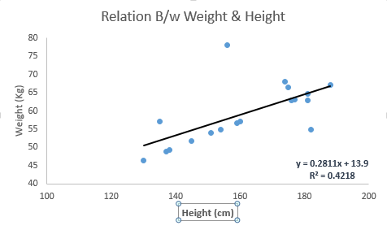
Supervised learning (Regression)
Relation between weight and height
x : Height (cm)
y : Weight (kg)
y=0.2811x+13.9 using this equation, we can find the weight, knowing the height of a person

Slide 24
Example 1
Linear Regression Example
Weight/Height dataset (25000 people)
We want to regress a line like Y= aX+b so that we will be able to find the Weight of a person given the Height
We evaluate the model by splitting the data into 90% training and 10% testing
Use MSE(Mean Square Error) and correlation to see how the model is doing

Slide 25
Supervised learning (Regression)
Economics/Finance: predict the value of a stock
Epidemiology
Car/plane navigation: angle of the steering wheel, acceleration
Temporal trends: weather over time

Slide 26
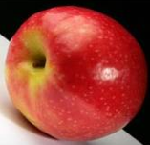
Unsupervised learning
Unsupervised learning: given data but no labels

Slide 27
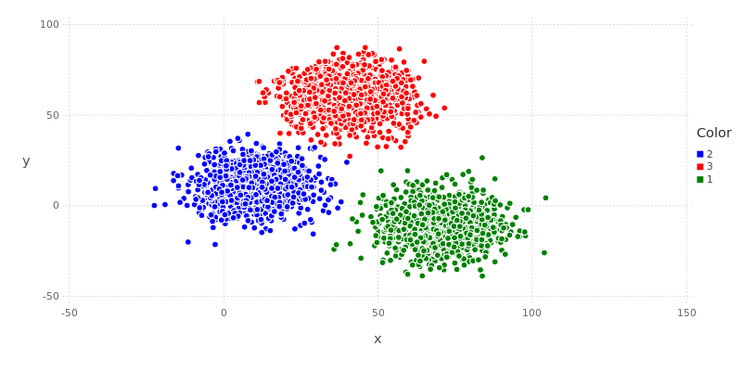
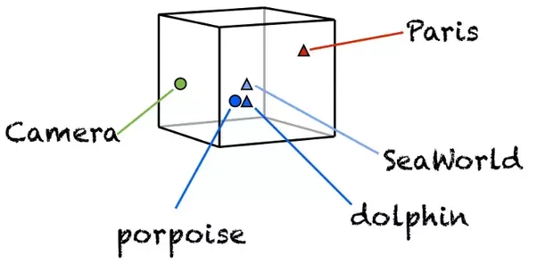
Unsupervised learning
Clustering (K-means, Hierarchical clustering)
Word Embedding (Word2vec, Glove)
Dimensionality reduction(PCA,)
Topic Modeling (LDA, LSI/LSA)
Others…

Slide 28
Reinforcement learning
Given a sequence of examples/states and a reward after completing that sequence, learn to predict the action to take in for an individual example/state
left, right, straight, left, left, left, straight
GOOD
left, straight, straight, left, right, straight, straight
BAD
left, right, straight, left, left, left, straight
+5
left, straight, straight, left, right, straight, straight
-5

Slide 29
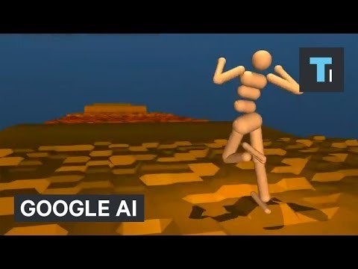
Reinforcement learning

Slide 30
Other types of learning
What data is available:
Supervised, Unsupervised, Reinforcement learning
Semi-supervised, Active learning, …
How are we getting the data:
Online vs. Offline learning

Slide 31
Common Machine Learning Algorithms
Linear Regression
Logistic Regression
Decision Tree
SVM
Naive Bayes
KNN
K-Means
Random Forest
Dimensionality Reduction Algorithms

Slide 32
Deep Learning

Slide 33
Introduction
AKA. deep neural networks, deep Neural nets…
How most researchers in computer science heard of it: Deep Learning is providing breakthrough results in speech recognition and image classification …
So what exactly is deep learning ? And why is it generally better than other methods on image, speech and certain other types of data?
The short answers:
‘Deep Learning’ means using a neural network with several layers of nodes between input and output
The series of layers between input & output do feature identification and processing in a series of stages, just as our brains seem to

Slide 34
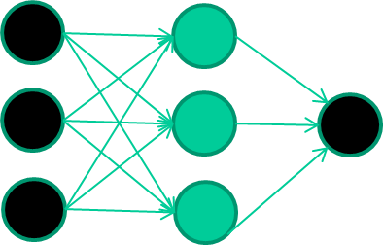
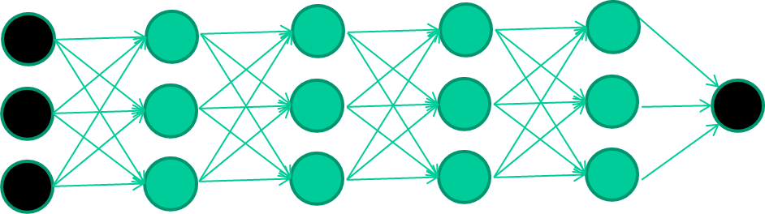
Introduction
Multilayer neural networks have been around for 25 years. What’s actually new?
We have always had good algorithms for learning the weights in networks with 1 hidden layer, but these algorithms are not good at learning the weights for networks with more hidden layers
what’s new is: algorithms for training many-layer networks
Input layer
Hidden layer
Output layer

Slide 35
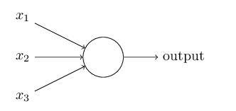
Perceptrons
Weights (W1, W2, W3)
Input
Results or output
Threshold
X1*W1+X2*W2+X3*W3

Slide 36
Perceptrons
Suppose the weekend is coming up, and you've heard that there's going to be a cheese festival in your city. You like cheese, and are trying to decide whether or not to go to the festival.
Is the weather good? (X1 binary, 1 for True and 0 for False)
Does your boyfriend or girlfriend want to accompany you? (X2 binary, 1 for True and 0 for False)
Is the festival near public transit? (X3 binary, 1 for True and 0 for False)
X1 = 1 W1 = 6
X2 = 0 W2 = 2
X3 = 0 W3 = 2
Threshold = 5
Result = Go

Slide 37
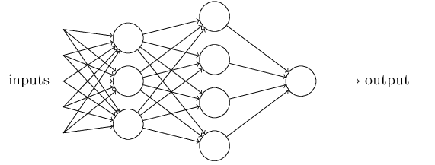
Network of perceptrons

Slide 38
Neural networks
weight-learning algorithms for NNs are dumb
they work by making thousands and thousands of tiny adjustments, each making the network do better at the most recent pattern, but perhaps a little worse on many others
but, by dumb luck, eventually this tends to be good enough to learn effective classifiers for many real applications

Slide 39
Topic Models

Slide 40
Introduction
A topic model is a type of statistical model for discovering the abstract “topics” that occur in a collection of documents
Topic models are a suite of algorithms that uncover the hidden thematic structure in document collections. These algorithms help us develop new ways to search, browse and summarize large archives of texts
Topic models provide a simple way to analyze large volumes of unlabeled text. A “topic” consists of a cluster of words that frequently occur together

Slide 41
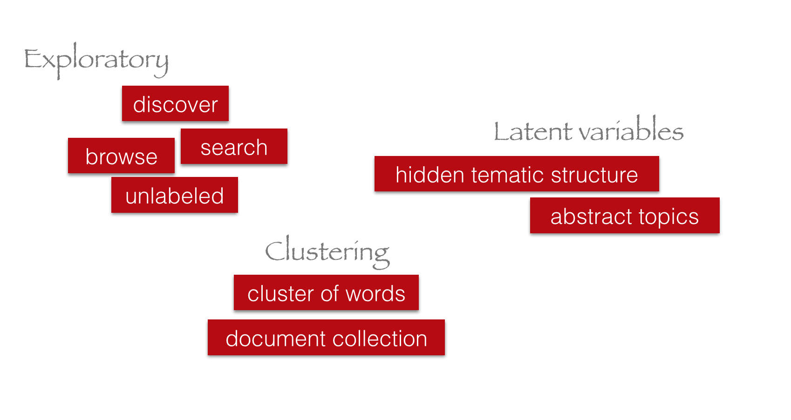
Introduction

Slide 42
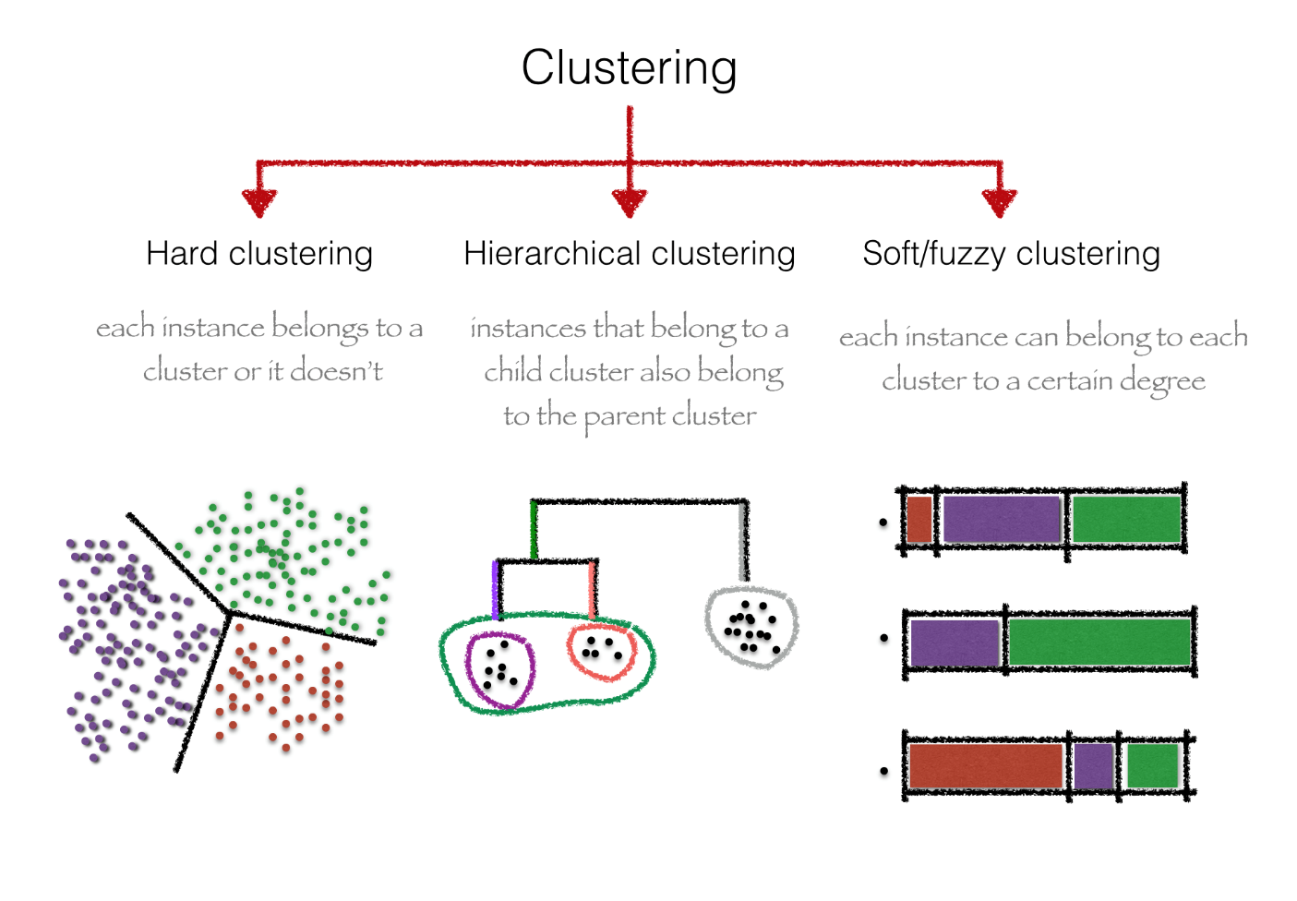
Introduction

Slide 43
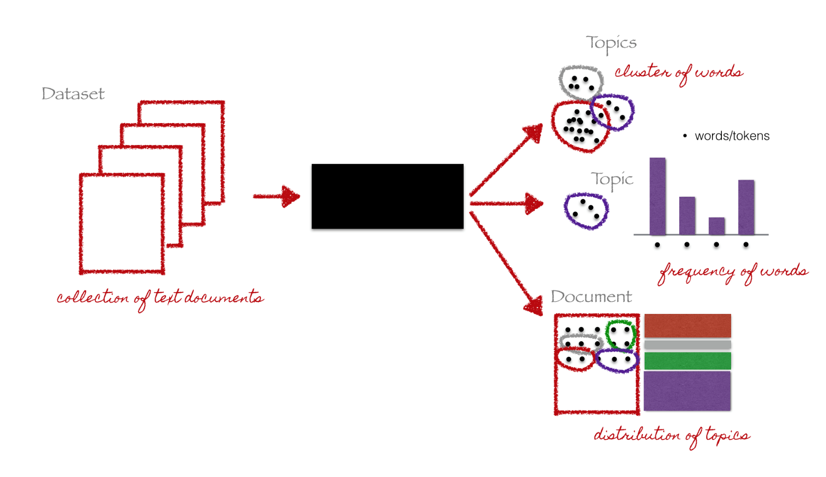
Introduction

Slide 44
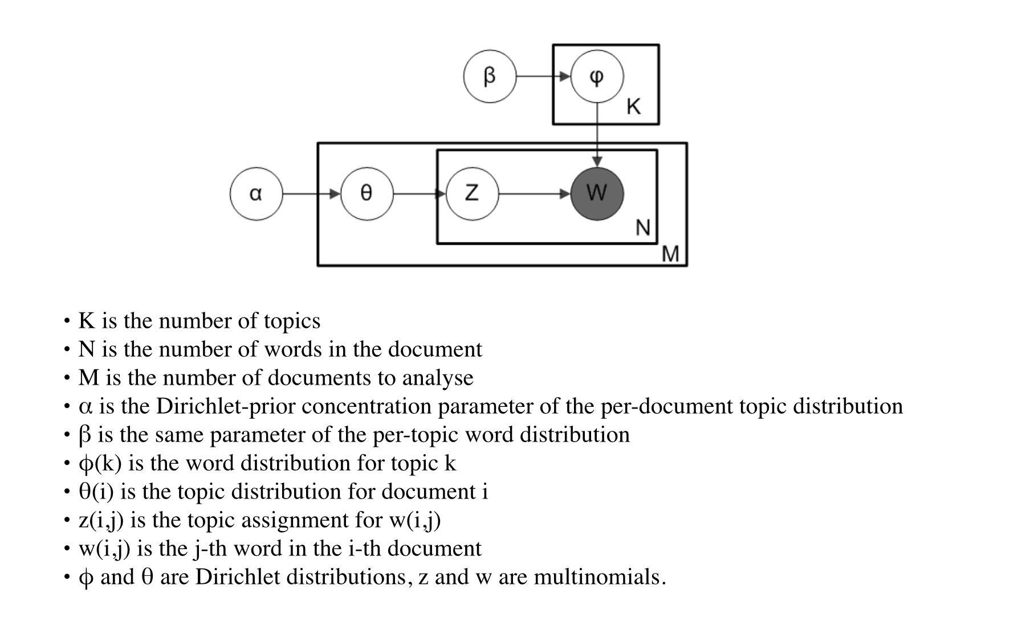
LDA (Latent Dirichlet Allocation)

Slide 45
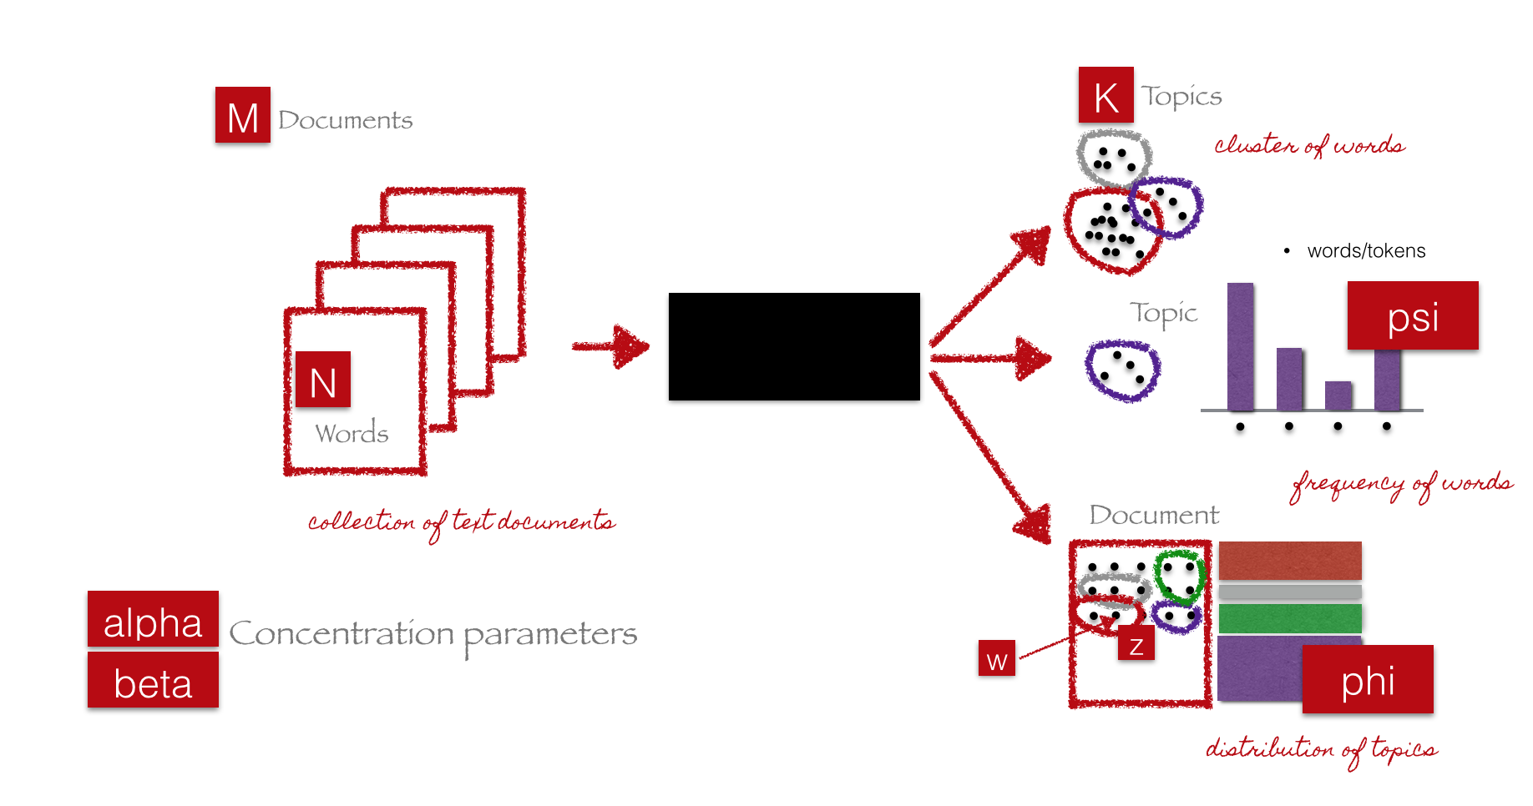
LDA (Latent Dirichlet Allocation)

Slide 46
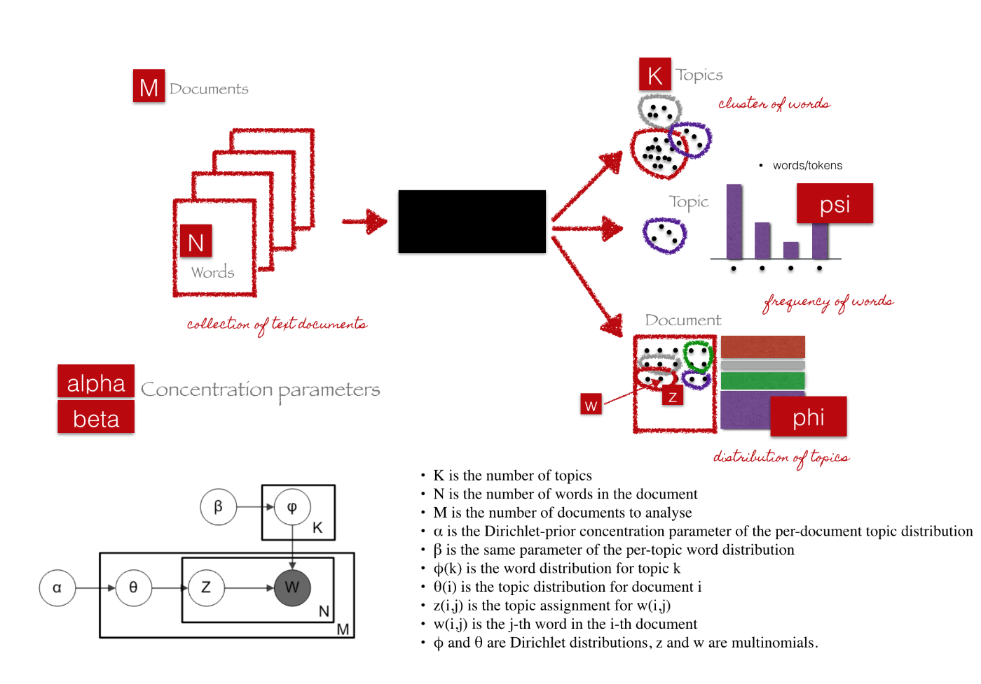
LDA (Latent Dirichlet Allocation)

Slide 47
LDA Algorithm
Initialize the parameters
Initialize topic assignments randomly
Iterate
For each word in each document:
Re-sample topic for word, given all other words and their current topic assignments
Get results
Evaluate model

Slide 48
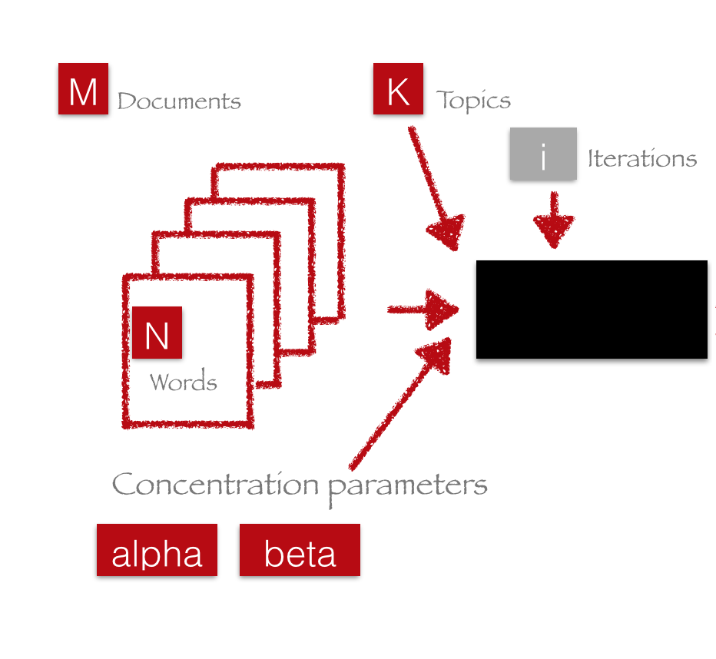
Initialize the parameters

Slide 49
LDA Algorithm
Initialize the parameters
Initialize topic assignments randomly
Iterate
For each word in each document:
Re-sample topic for word, given all other words and their current topic assignments
Get results
Evaluate model

Slide 50
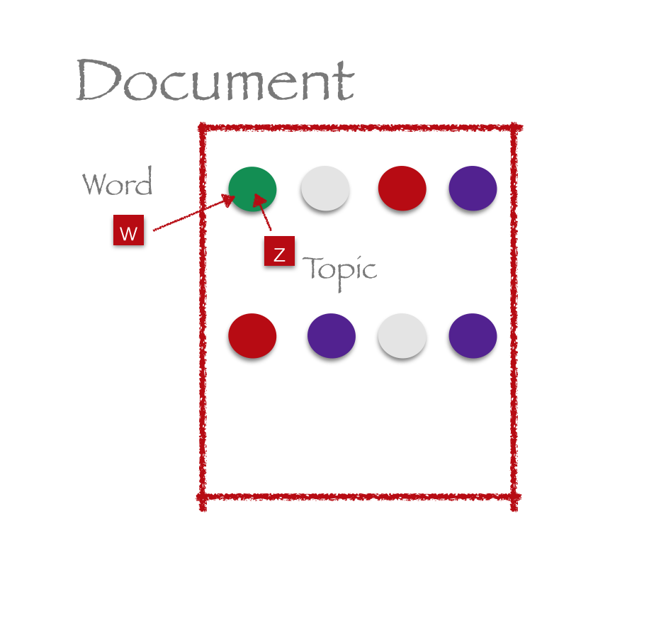
Initialize topic assignments randomly

Slide 51
LDA Algorithm
Initialize the parameters
Initialize topic assignments randomly
Iterate
For each word in each document:
Re-sample topic for word, given all other words and their current topic assignments
Get results
Evaluate model

Slide 52
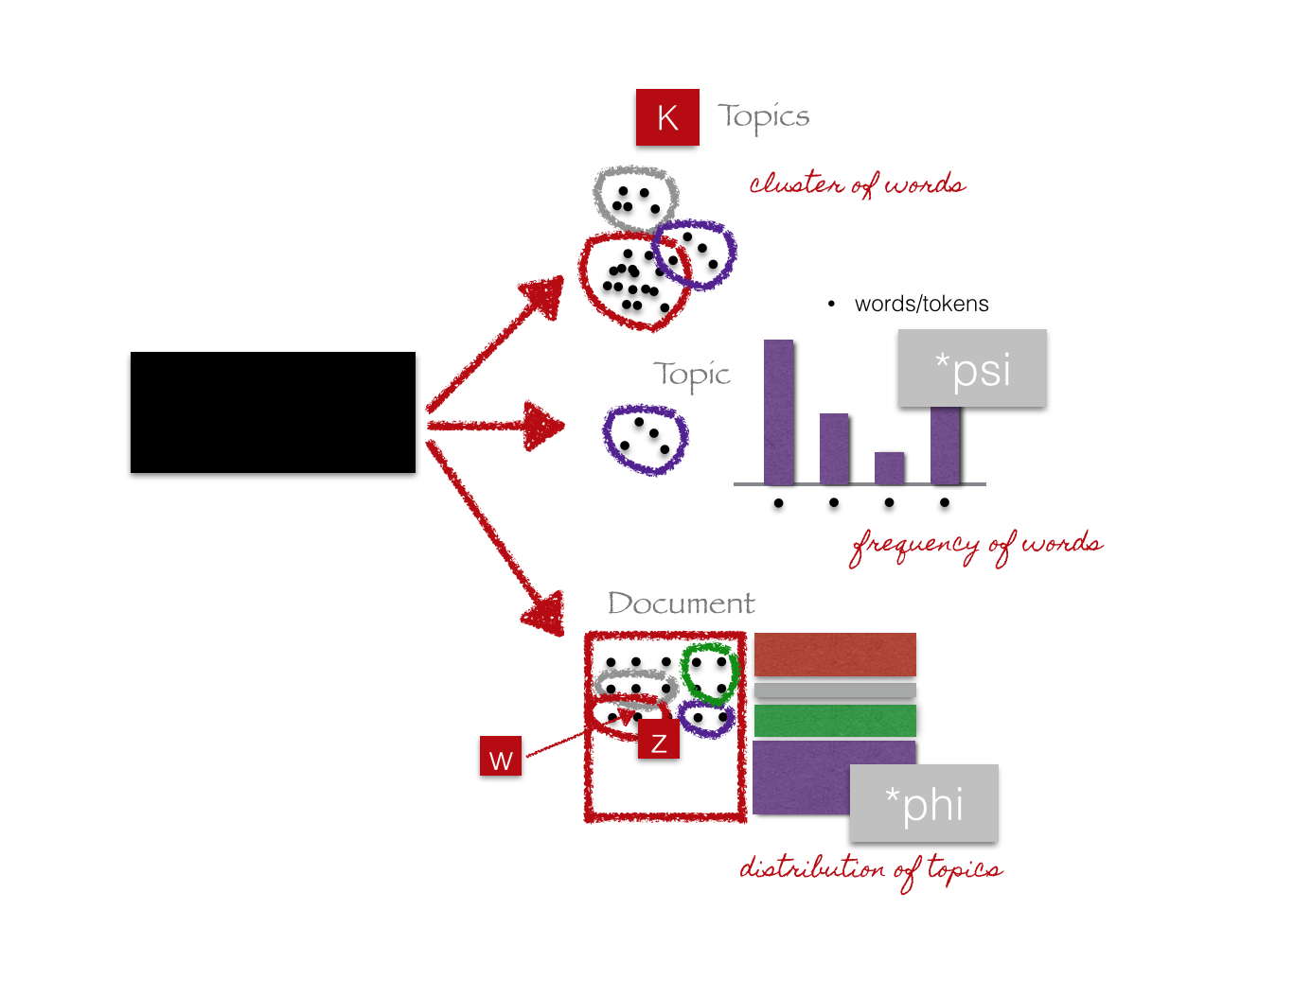
Iterate

Slide 53
LDA Algorithm
Initialize the parameters
Initialize topic assignments randomly
Iterate
For each word in each document:
Re-sample topic for word, given all other words and their current topic assignments
Get results
Evaluate model

Slide 54
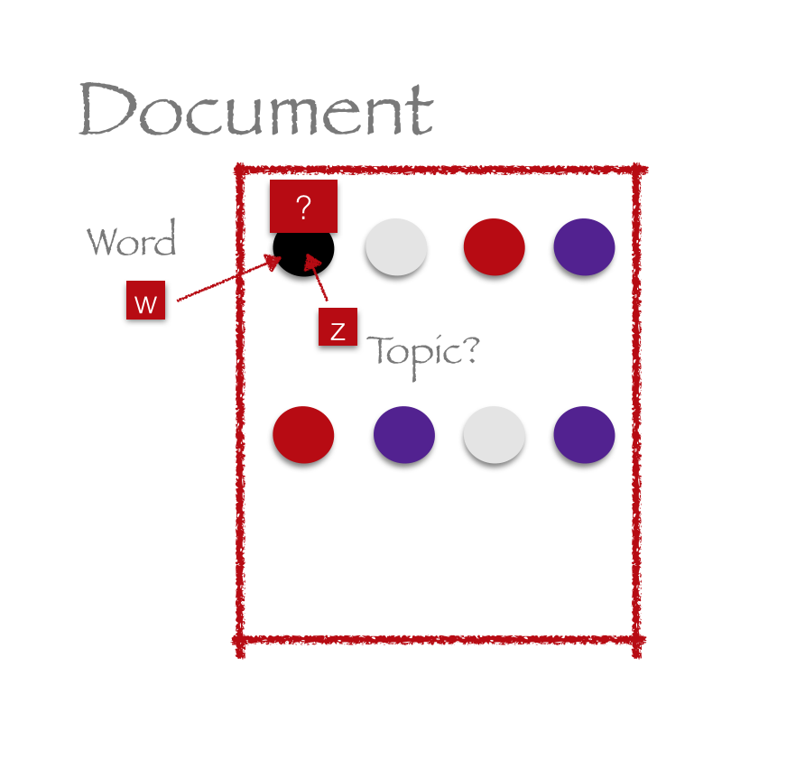
Re-sample topic for word, given all other words and their current topic assignments
Which topics occur in this document?
Which topics like the word X?

Slide 55
LDA Algorithm
Initialize the parameters
Initialize topic assignments randomly
Iterate
For each word in each document:
Re-sample topic for word, given all other words and their current topic assignments
Get results
Evaluate model

Slide 56
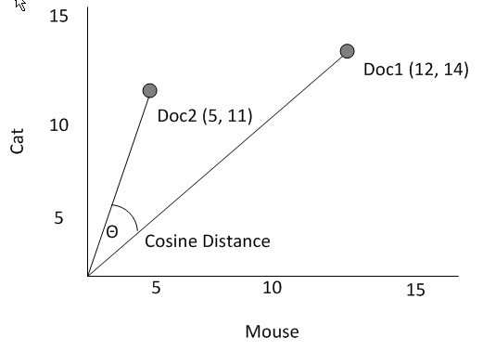
Evaluate model
Cosine similarity: split each document into two parts, and check that topics of the first half are similar to topics of the second halves of different documents are mostly dissimilar

Slide 57
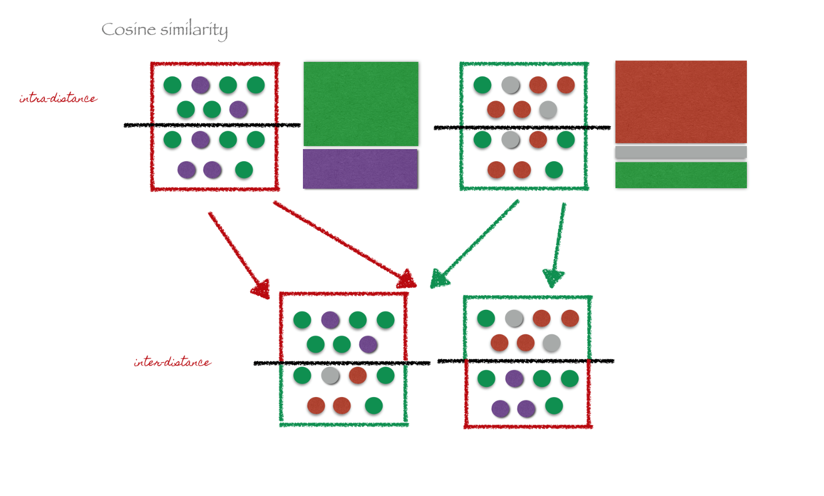
Evaluate model

Slide 58
Thanks for listening.
Q/A?

